Slide 1
SUBNETTING

Slide 2
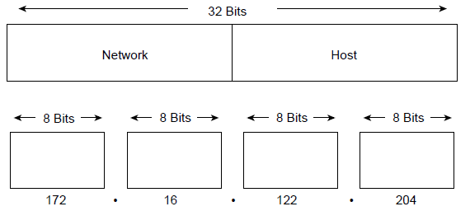
IP Address Format
The 32-bit IP address is grouped eight bits at a time, separated by dots, and represented in decimal format.
Each bit in the octet has a binary weight (128, 64, 32,16, 8, 4, 2, 1).
The minimum value for an octet is 0, and the maximum value for an octet is 255.

Slide 3
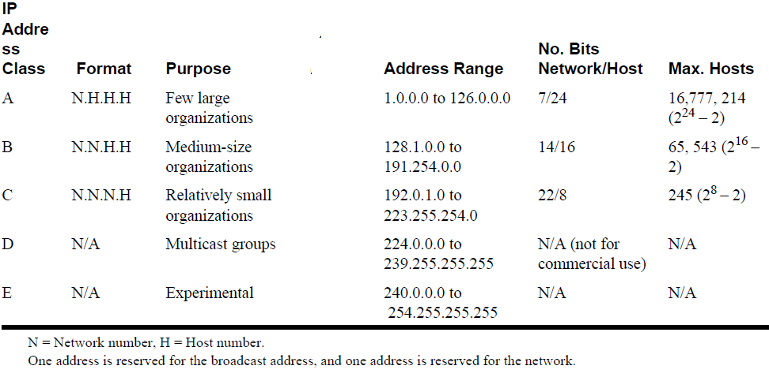
IP addressing supports five different address classes: A, B,C, D, and E. Only classes A, B, and C are available for commercial use

Slide 4
IP Subnet Addressing
IP networks can be divided into smaller networks called subnetworks (or subnets).
For example, 172.16.1.0, 172.16.2.0, 172.16.3.0, and 172.16.4.0 are all subnets within network 171.16.0.0. (All 0s in the host portion of an address specifies the entire network.)

Slide 5
Subnet Example
Network address 172.19.0.0 with /16 network mask
Network
Network
Host
Host
172
19
0
0
Using Subnets: subnet mask 255.255.255.0 or /24
Network
Network
Subnet
Host
Network Mask: 255.255.0.0 or /16
11111111
11111111
00000000
00000000
Subnet Mask: 255.255.255.0 or /24
11111111
11111111
11111111
00000000
Applying a mask which is larger than the default subnet mask, will divide your network into subnets.
Subnet mask used here is 255.255.255.0 or /24

Slide 6
Subnet Example
Network address 172.19.0.0 with /16 network mask
Using Subnets: subnet mask 255.255.255.0 or /24
Network
Network
Subnet
Host
172
19
0
Host
Subnets
172
19
1
Host
172
19
2
Host
255 Subnets
2⁸ - 1
172
19
3
Host
172
19
etc.
Host
172
19
254
Host
Cannot use last subnet as it contains broadcast address
172
19
255
Host

Slide 7
Subnet Example
Network address 172.19.0.0 with /16 network mask
Using Subnets: subnet mask 255.255.255.0 or /24
Network
Network
Subnet
Host
172
19
0
0
Subnets Addresses
172
19
1
0
172
19
2
0
255 Subnets
2⁸ - 1
172
19
3
0
172
19
etc.
0
172
19
254
0
Cannot use last subnet as it contains broadcast address
172
19
255
0

Slide 8
Subnet Example
Class B address 172.19.0.0 with /16 network mask
Using Subnets: subnet mask 255.255.255.0 or /24
Hosts Addresses
Network
Network
Subnet
Hosts
172
19
0
1
254
172
19
1
1
254
172
19
2
1
254
172
19
3
1
254
172
19
etc.
1
254
172
19
254
1
254
Each subnet has 254 hosts, 2⁸ – 2
172
19
255
Host

Slide 9
Subnet Example
Network address 172.19.0.0 with /16 network mask
Using Subnets: subnet mask 255.255.255.0 or /24
Network
Network
Subnet
Host
172
19
0
255
Broadcast Addresses
172
19
1
255
172
19
2
255
255 Subnets
2⁸ - 1
172
19
3
255
172
19
etc.
255
172
19
254
255
Cannot use last subnet as it contains broadcast address
172
19
255
255

Slide 10
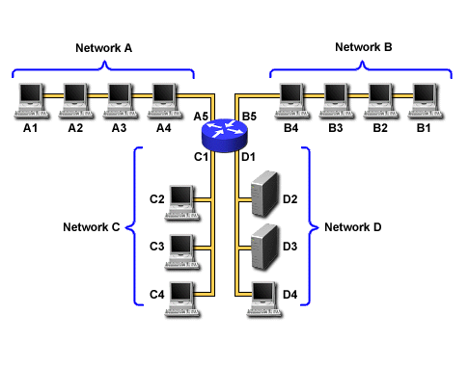
Subnet Example
Network address 172.19.0.0 with /16 network mask
Using Subnets: subnet mask 255.255.255.0 or /24
172.19.0.0/24
172.19.10.0/24
172.19.5.0/24
172.19.25.0/24

Slide 11
Important things to remember about Subnetting
You can only subnet the host portion, you do not have control of the network portion.
Subnetting does not give you more hosts, it only allows you to divide your larger network into smaller networks.
When subnetting, you will actually lose host adresses:
  For each subnet you lose the address of that subnet
  For each subnet you lose the broadcast address of that subnet
  You “may” lose the first and last last subnets
Why would you want to subnet?
  Divide larger network into smaller networks
  Limit layer 2 and layer 3 broadcasts to their subnet.
  Better management of traffic.

Slide 12
Subnetting – Example
Host IP Address: 138.101.114.250
Network Mask: 255.255.0.0 (or /16)
Subnet Mask: 255.255.255.192 (or /26)
Given the following Host IP Address, Network Mask and Subnet mask find the following information:
Major Network Information
  Major Network Address
  Major Network Broadcast Address
  Range of Hosts if not subnetted
Subnet Information
  Subnet Address
  Range of Host Addresses (first host and last host)
  Broadcast Address
Other Subnet Information
  Total number of subnets
  Number of hosts per subnet

Slide 13
Major Network Information
Host IP Address: 138.101.114.250
Network Mask: 255.255.0.0
Subnet Mask: 255.255.255.192
Major Network Address: 138.101.0.0
Major Network Broadcast Address: 138.101.255.255
Range of Hosts if not Subnetted: 138.101.0.1 to 138.101.255.254

